Slide 1
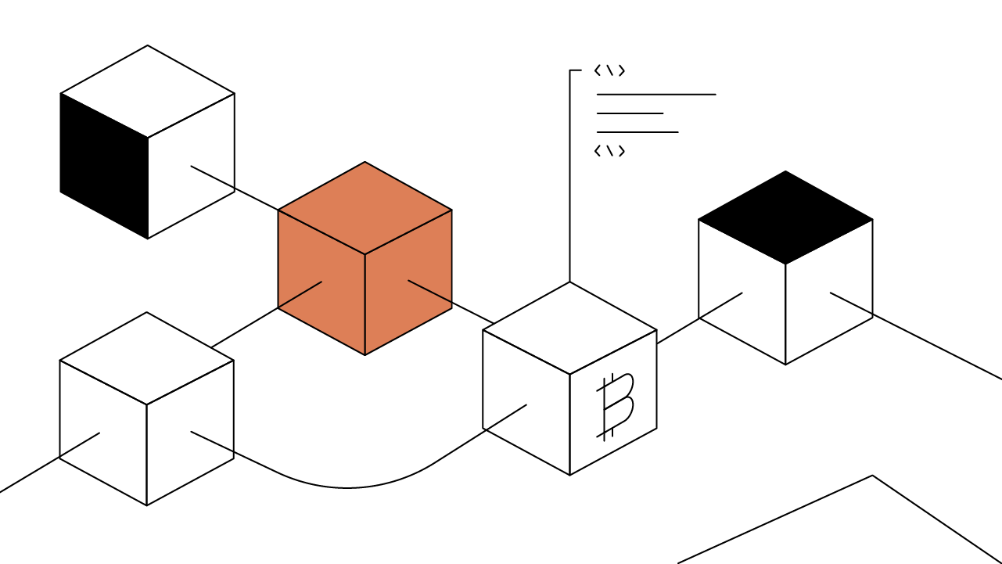
INTRODUCTION TO BLOCKCHAIN TECHNOLOGY

Slide 2
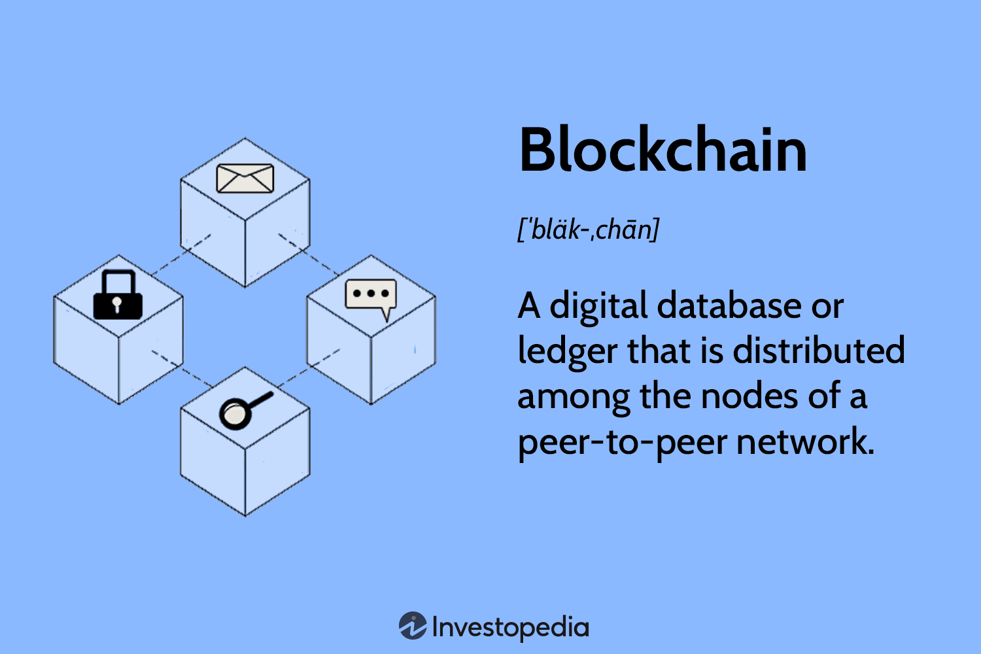
Introduction to Blockchain Technology
Definition and Origin: Blockchain, introduced by Satoshi Nakamoto through the paper "Bitcoin: A Peer-to-Peer Electronic Cash System," is a decentralized digital ledger system. It stores data across multiple computers, ensuring transparency, security, and immutability.
Impact on Digital Transformation: Blockchain has accelerated digital transformation globally, enhancing globalization and pushing for the adoption of digital systems in various sectors. Its transparency and security features have revolutionized how transactions and data management are handled.

Slide 3
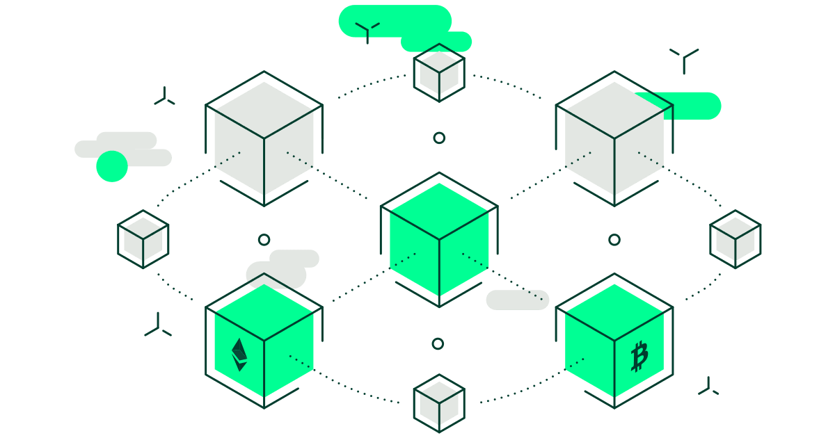
Historical Background
Early Development: Concepts similar to blockchain were discussed in the 1990s, focusing on timestamps and secure digital records. Key milestones include.
Modern Blockchain: Nakamoto's blockchain model for Bitcoin marked the beginning of modern blockchain technology, enabling secure, decentralized transactions without intermediaries

Slide 4
Motivation for Blockchain Adoption
Traditional System Limitations: Centralized systems are prone to failures, data breaches, and lack transparency, leading to corruption and inefficiencies.
Blockchain Solutions:
- Security: Enhanced through distributed and encrypted data storage.
-Transparency: Publicly verifiable transactions reduce fraud. - Efficiency: Removal of intermediaries accelerates processes and reduces costs. - Automation: Smart contracts automate and streamline business processes.

Slide 5
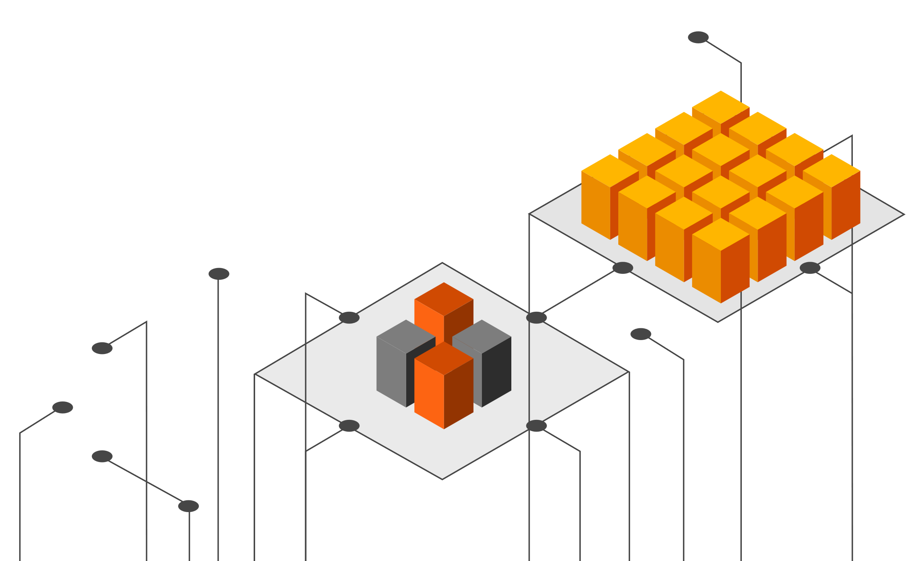
Applications of Blockchain
- Finance: Cryptocurrencies for payments and trading.
- Supply Chain Management: Tracking product origins and movements.
- Healthcare: Secure patient record storage and sharing.
- Voting Systems: Ensuring secure and transparent elections.
- Energy Sector: Managing renewable energy markets and reducing energy theft.

Slide 6
Hypotheses for Blockchain Impact
1. Finance: More reliable and cost-effective than traditional banking for payments and transfers.
2. Supply Chain Management: Increases traceability and reduces fraud.
3. Voting: Enhances election security and reduces vote tampering.
4. Healthcare: Improves patient record security and reduces data manipulation.
5. Real Estate: Ensures accurate property records and prevents fraud.
6. Energy: Optimizes distribution and reduces theft.
7. Education: Secures student achievement data and maintains data integrity.

Slide 7
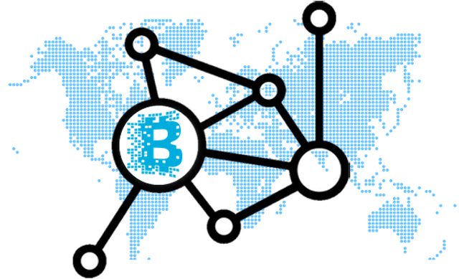
Research Methodology
- Literature Review: Examined academic articles, conference papers, and industry reports to understand blockchain applications and challenges.
- Evaluation of Existing Projects: Assessed real-world blockchain implementations across various sectors.
- Applied Research: Conducted pilot projects to demonstrate blockchain's impact in specific industries.
- Data Analysis: Used qualitative and quantitative methods to evaluate findings.

Slide 8
Significance of the Study
Sectoral Transformation: Highlights blockchain's potential to revolutionize industries such as finance, healthcare, and supply chain management.
- Technological Innovation: Emphasizes blockchain's role in driving technological advancements.
- Trust and Transparency: Examines how blockchain fosters trust and transparency in data management.
- Societal and Economic Impacts: Discusses the broader implications of widespread blockchain adoption on society and economy.

Slide 9
Conclusion
- Key Findings: Blockchain technology is crucial for secure, transparent, and efficient data management. It offers significant benefits but also faces challenges like scalability and regulatory issues.
- Future Research: Further studies are needed to develop solutions for these challenges and expand blockchain applications across more sectors.

